Slide 1

Automated Segmentation and Classification of Chemical and other Equations from document images
Prerana Jana
Anubhab Majumdar
4th year, IIEST Shibpur

Slide 2
Overview
Introduction
Motivation
Previous Work
Future Work
Proposed Work
Experimental Result
Error Analysis

Slide 3

Introduction

Slide 4
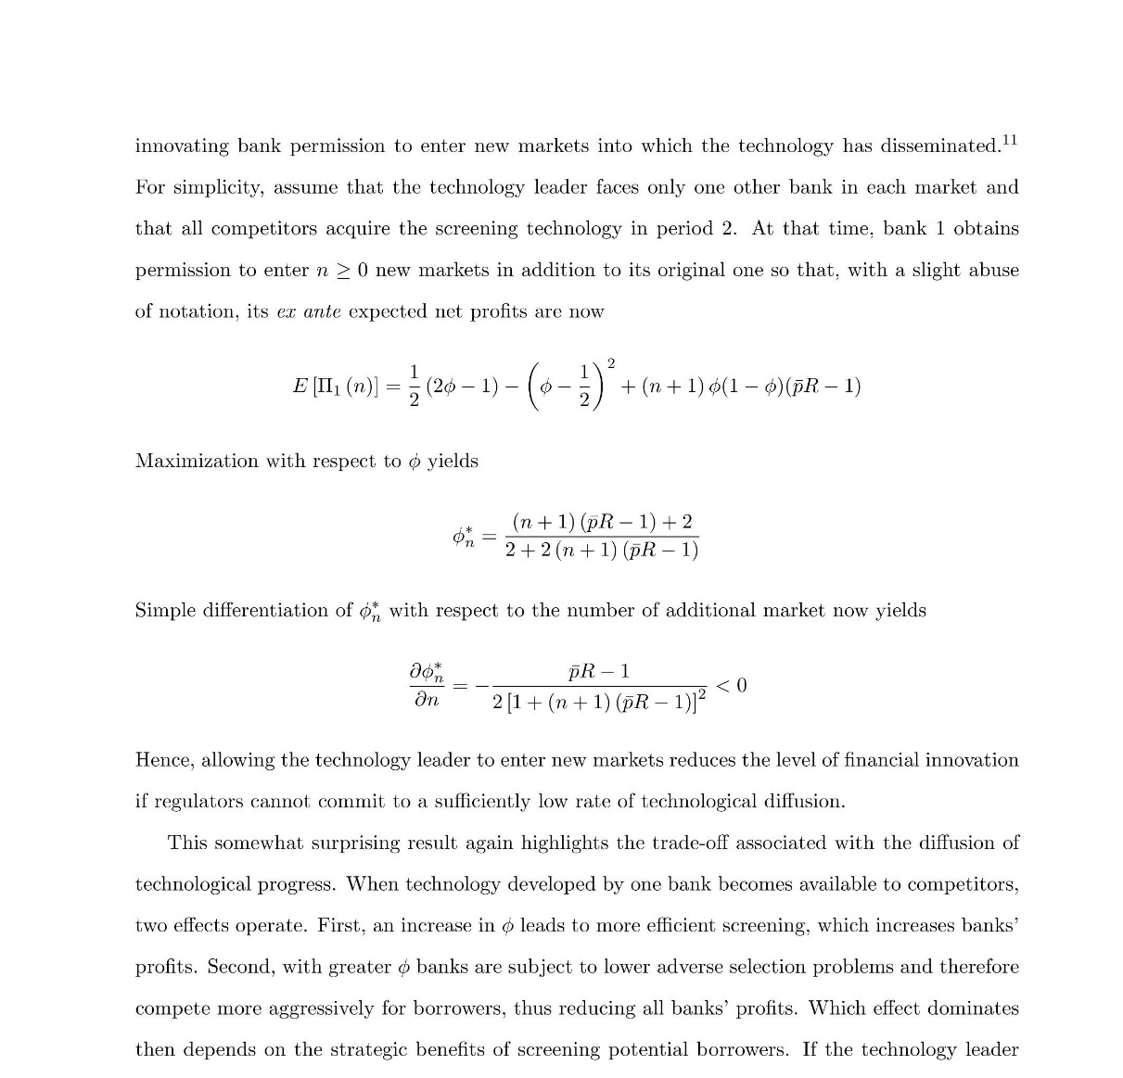
Mathematical Equations Segmentation
Is Possible!

Slide 5

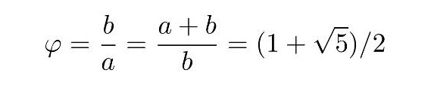
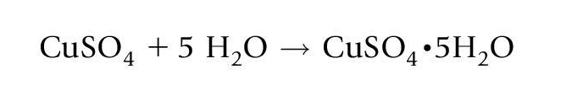

But what about chemical equations ???
Chemical equations share similar spatial properties as mathematical equations

Slide 6
Motivation
Segment out chemical equations from document images having both chemical and other equations
This improves OCR performance
Creation of chemical database in latex format
Creation of bond electron matrix
Balancing of chemical equations

Slide 7
Previous Work
This study is a first of its kind as far as our knowledge goes
Most equation segmentation work has been targeted towards mathematical equations
Few techniques applied for the purpose :
Symbol Recognition
Character size and font information with Bag of word model – math and text bag
Check text style ( italic, bold or regular) at the character level
All the above mentioned procedures can’t differentiate mathematical equations from chemical equations

Slide 8
Proposed Work
1
Text Line Segmentation
2
Blob formation using morphological tools
3
Operator Identification
4
5
Displayed Equation(DE) zone segmentation
Classification of DE zones into chemical and other zones

Slide 9
Pre-Processing
Remove small components like
Dots of ‘i’, ‘j’
Small punctuations like , ; .
This is done by component labelling and using a suitable threshold

Slide 10
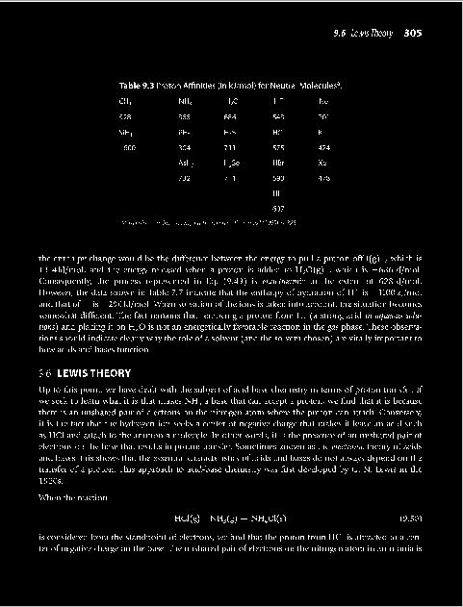

Text Line Segmentation
Text document
Horizontal Projection Profile

Slide 11
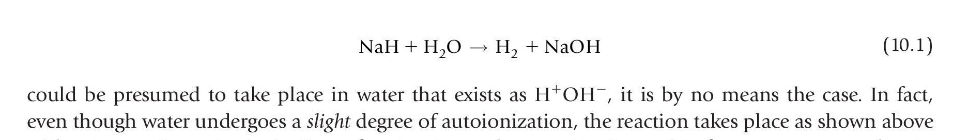
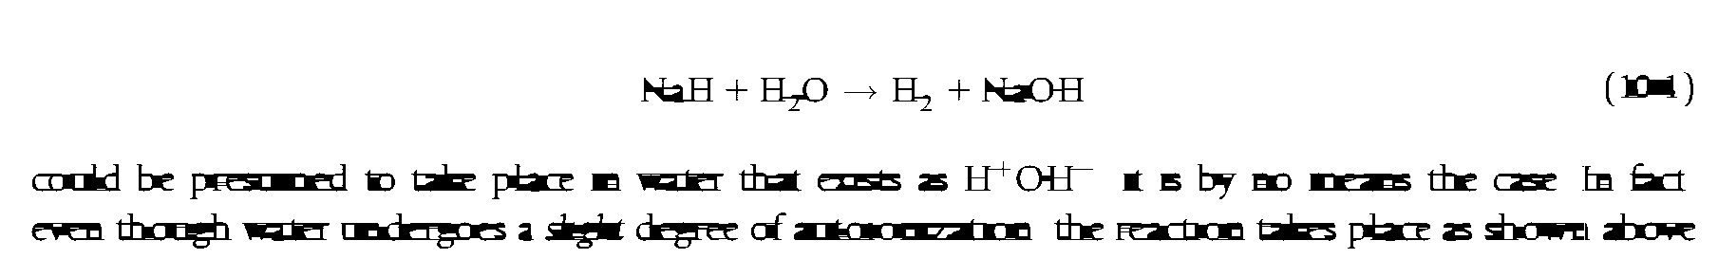
Blob Formation using Morphological Operations
Structural element used is a LINE
How to determine its length ?

Slide 12
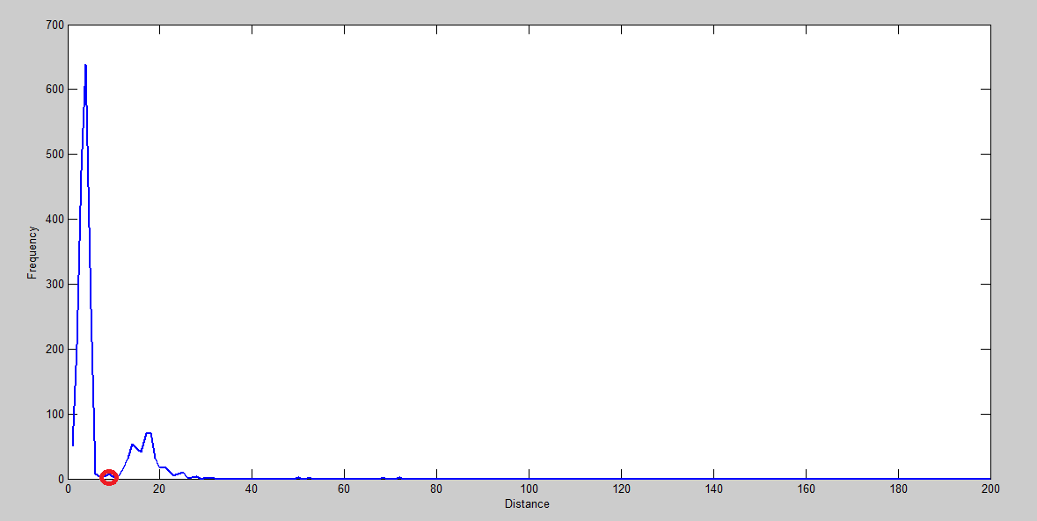
Determining Gap between Characters and Word
Length of structural element should be greater than the gap between 2 letters in a word but less than the gap between 2 words
Gap between letters
Length of Structural element
Gap between words
Document image
Histogram of character gap

Slide 13
Operator Identification – Single Character Extraction

Slide 14
Operator Identification – Euler Number based removal

Slide 15
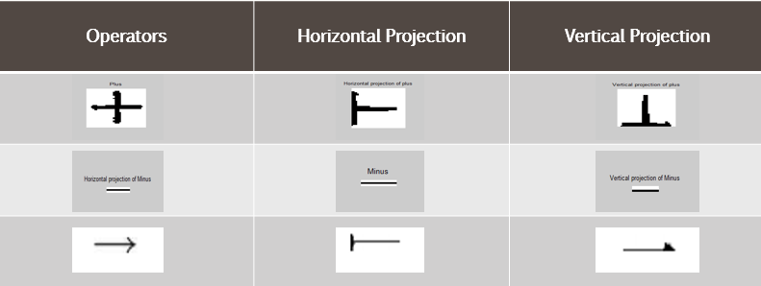
Operator Identification – Feature Extraction
The following features are considered for remaining single characters :
Aspect ratio of each component
Density (#object pixel/#total pixel)
Second and third order moments of horizontal and vertical projection profile
The location and magnitude of global maxima in horizontal and vertical projection profile
Perimeter of the component

Slide 16
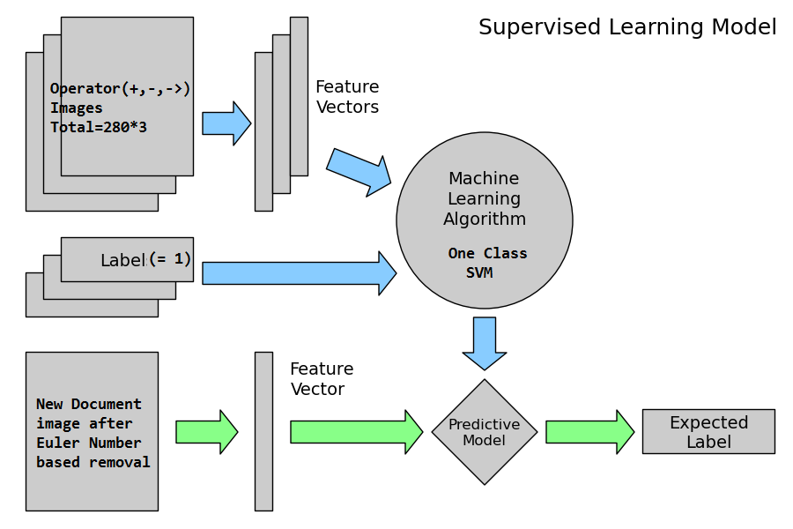
Operator Identification – One Class SVM
Accuracy on
752 equations – 98.4%

Slide 17
After Operator Identification - sample output

Slide 18
Identifying ‘=’ or ‘ ’
‘=’ or ‘ ’doesn’t form a word blob
The upper and lower part is identified as thin character : ‘-’ or ‘→’
For every thin character detection we place a mask of size (l*l/2) on top and bottom to check presence of another such symbol where l=length of the thin operator.
If present, we join them together and it forms one single operator.

Slide 19


Adding numerator and denominator
Original Equation
Lower Scan
Upper Scan
Final Equation

Slide 20
Segmentation of DE zones - Run Length Smoothing on Operands

Slide 21
Segmentation of DE zones - Equation Number Removal

Slide 22

Segmentation of DE zones – Displayed or Embedded?
Count operands in CDE
Count operators on CDE
A CDE is considered as a DE if
#Operands $≤$ 2*(#Operators )
This is because any operator will have at most 2 operators on its either side

Slide 23
Classification of Segmented DE zones – Removal of Subscripts and Superscripts
Subscripts ᗴ (Lower middle zone, Bottom Zone)
Superscripts ᗴ (Upper middle zone, Upper zone)
Chemical elements won’t be subscript or superscript; so they are ignored

Slide 24

Classification of Segmented DE zones – OCR
Rest are input into Google Tesseract 3.02, an open-source OCR engine, which returns the text form.

Slide 25
Classification of Segmented DE zones – Parser
Regular expression for a periodic element
[A-Z][a-z]*
Grammar for substrings that can be an element:
start → capital . follow
follow → small . follow | ᗴ
capital → A|B|C|…|X|Y|Z
small → a|b|c|…|x|y|z

Slide 26
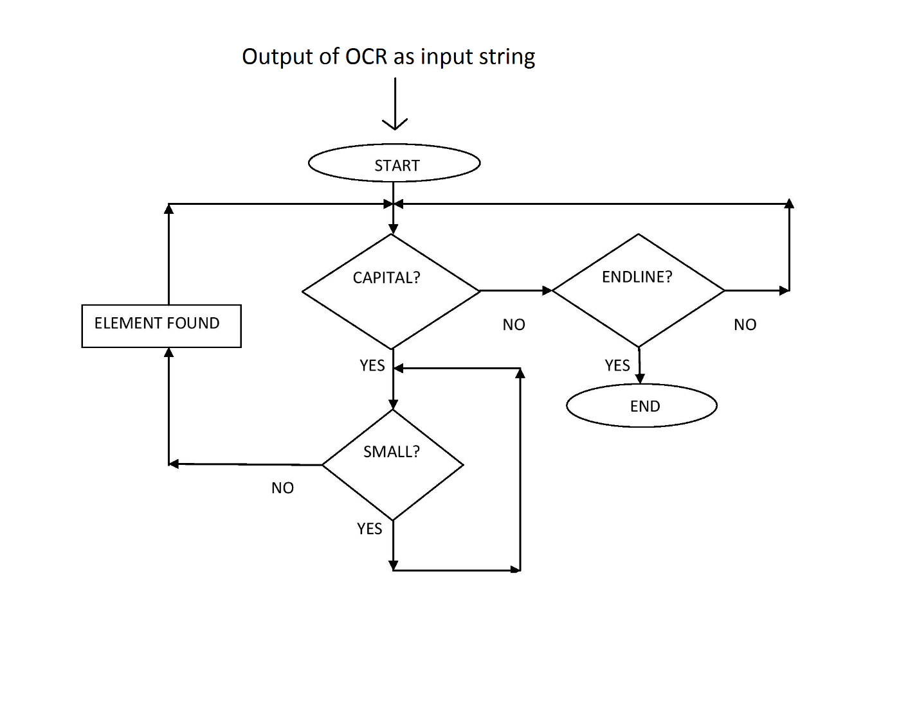
Flowchart of the working mechanism of the parser

Slide 27
Classification of Segmented DE zones – Chemical or Other?
The substrings are matched against a hash table consisting of all the elements in the Periodic Table
If #(elements matched) : #(total substrings) ≥ 0.7 then the DE is considered as chemical equation (according to our experiment with 733 equations)
Why 0.7, not 1?
Limitation of OCR
Presence of broken and touching character in DE zone

Slide 28
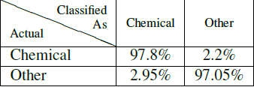
Experimental Result
Algorithm implemented on MATLAB R2014a
Total document images → 152
Total displayed equations → 752

Slide 29
Error Analysis – I. Segmentation Error
Case 1:
Case 2:

Slide 30
Error Analysis – II. Classification Error

Slide 31
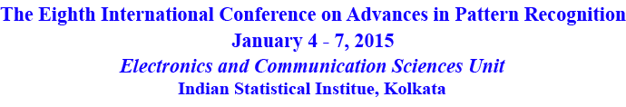
This work has been accepted in

Slide 32


Future Work -
Correction of the segmentation error for reactants over the arrow
Bond Electron Matrix Formation
→ Recognizing Subscripts and Superscripts
→ Auto-correction of OCR output using Context Analysis

Slide 33
Thank you!

Slide 34


